Slide 1

COMPETENCIES FOR THE INDUSTRY OF THE FUTURE
Primož KURENT, BSc Engineering
ŠC Kranj, Višja strokovna šola, Kranj, Slovenia
kurent.primoz@gmail.com
LJUBLJANA 04. 10. 2017

Slide 2

SkillME
GOOD PRACTICES IN SKILLS DEVELOPMENT
IN THE METAL AND ELECTRO INDUSTRY
GLOBALISATION
Fast progress
Products & Services
IT technology
Industry

Slide 3
SkillME
GOOD PRACTICES IN SKILLS DEVELOPMENT
IN THE METAL AND ELECTRO INDUSTRY
Complex
Theory and
practical work
NEW TECHNOLOGIES
(COMPOSITE MATERIALS)
Competent experts
Teamwork
Industry
Educational institutions
Chamber of Commerce
Different legal entities

Slide 4
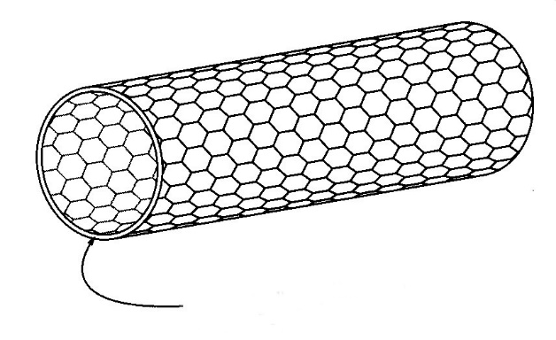
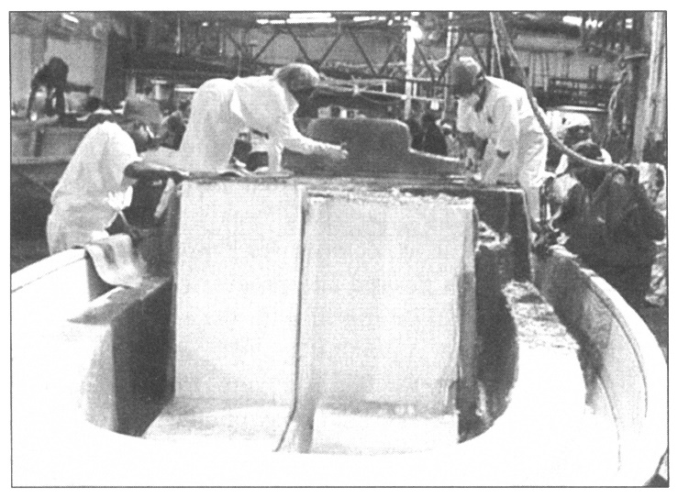
SkillME
GOOD PRACTICES IN SKILLS DEVELOPMENT
IN THE METAL AND ELECTRO INDUSTRY
Theory:

Slide 5
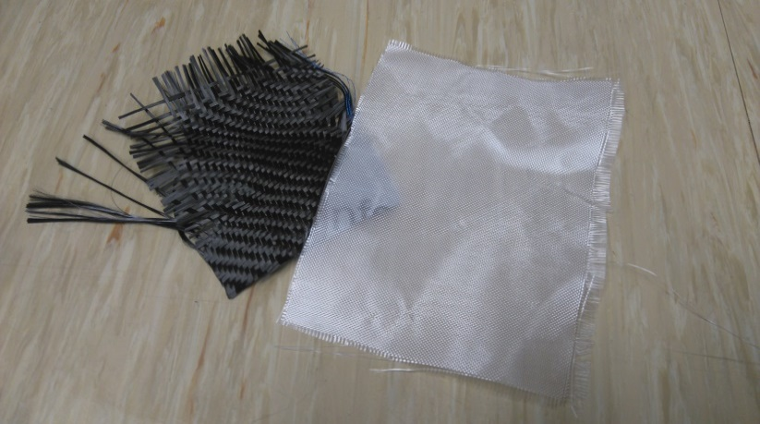
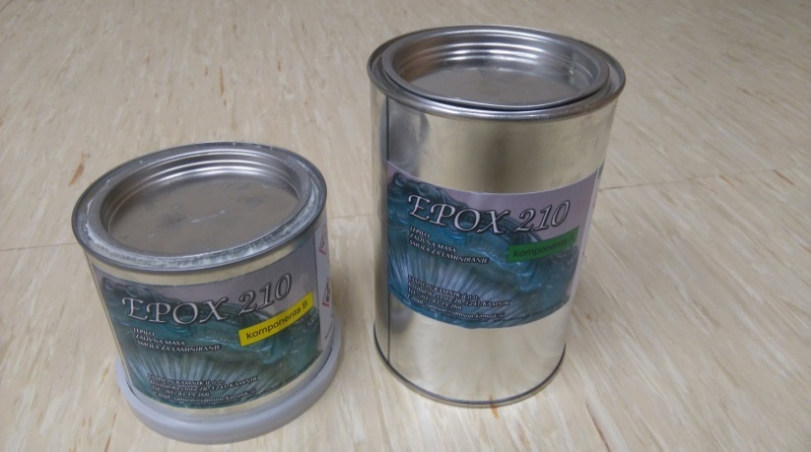
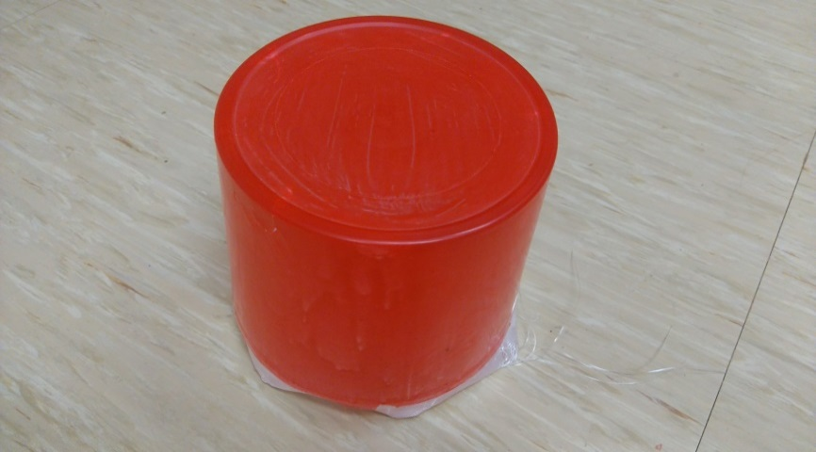
SkillME
GOOD PRACTICES IN SKILLS DEVELOPMENT
IN THE METAL AND ELECTRO INDUSTRY
Practical work:

Slide 6

skillME
GOOD PRACTICES IN SKILLS DEVELOPMENT
IN THE METAL AND ELECTRO INDUSTRY
CONCLUSION
Innovative approach of integration of future technologies in high schools and colleges.
I believe that such projects are necessary in the future and this is why we will proceed with such successful practice also in the upcoming years.

